Slide 1

Cocoon Corners for OCC
By: Jacob Mori
Special shoutouts: Gautham, Tallulah, Oriana, Manvi, Joseph, Jas, Camila, Tyler, Haeley
Notes:
1st Gr Red Rooms
2nd Gr Red Rooms
Clubhouse

Slide 2
Cocoon Corners for OCC
CLICK HERE
Notes:
1st Gr Red Rooms
2nd Gr Red Rooms
Clubhouse

Slide 3
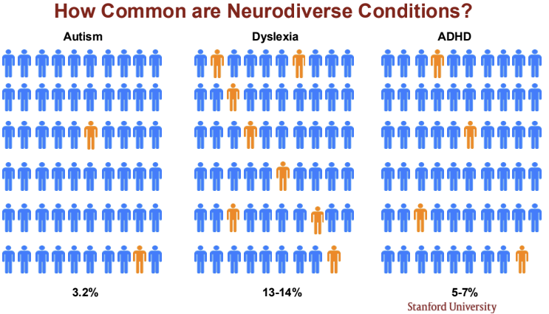
Problem Statement
Some kids get overstimulated in loud and sometimes uncontrollable situations and rooms
There are not enough areas for kids to take time to themselves and to decompress
Churches lack resources for a disability ministry or sensory rooms and corners for neurodiverse kids
Churches sometimes have trouble making sure that all individuals are included and have different things for neurodiverse individuals to do if one activity is not an option
Churches and organizations in general have a hard time creating welcoming spaces for neurodiverse and neurotypical individuals (Everyone should be able to participate in an activity!)
Church volunteers are sometimes not trained to accommodate neurodiverse students.

Slide 4

Ensuring ALL students experience the love of God is a core part of Overlake’s vision!

Slide 5
Why this is important to me
-I am neurodiverse myself (ADHD) and I want to help children who may be struggling in Sunday School.
-When I was in Sunday school, kids like me didn't have access to sensory areas or even quiet spaces to hang out so we could experience God’s love in a way that worked for us.
-I was often told to “be quiet” or “sit still”, and would sometimes get taken out of class because I didn’t have anywhere or anyone to help me.

Slide 6
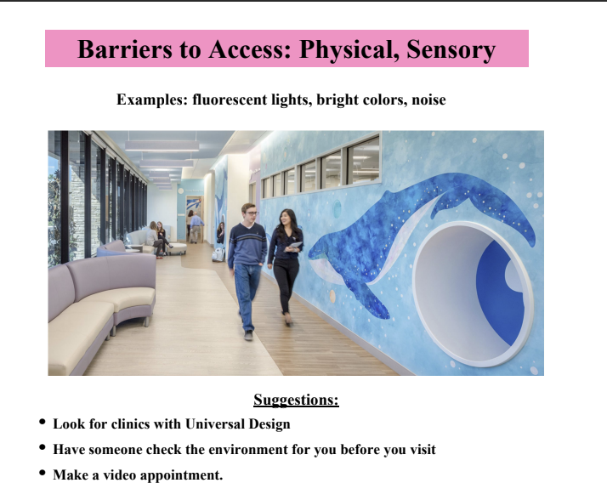
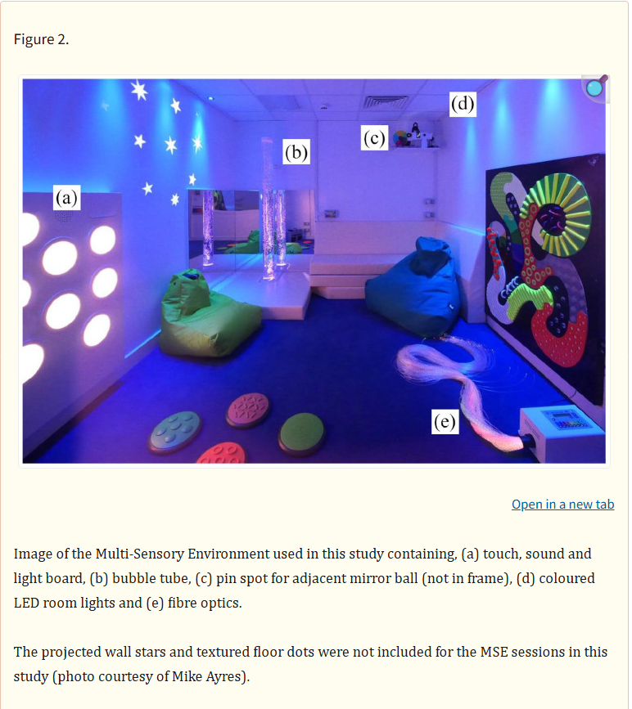
2025 SNP-Reach
…My first step was attending the 2025 SNP Reach to understand evidence-based solutions!
https://pmc.ncbi.nlm.nih.gov/articles/PMC9340127/
https://www.cdc.gov/adhd/treatment/classroom.html
Things that should be included in sensory rooms are, colored or dimmed lighting, bubble tubes, fibre optic cables, Touch, sound, and light boards, Sensory boards, Sensory carpets, Bean bag cushions
Notes:
“We found that when autistic children could control the sensory equipment, they paid more attention and performed fewer repetitive and sensory behaviours. They also used less stereotyped speech, produced fewer vocalisations and showed lower levels of activity. Other behaviours were not affected. Our findings demonstrate that how a Multi-Sensory Environment is used can impact behaviour and that providing control of sensory changes to autistic children may help create better conditions for learning.” Article 1

Slide 7
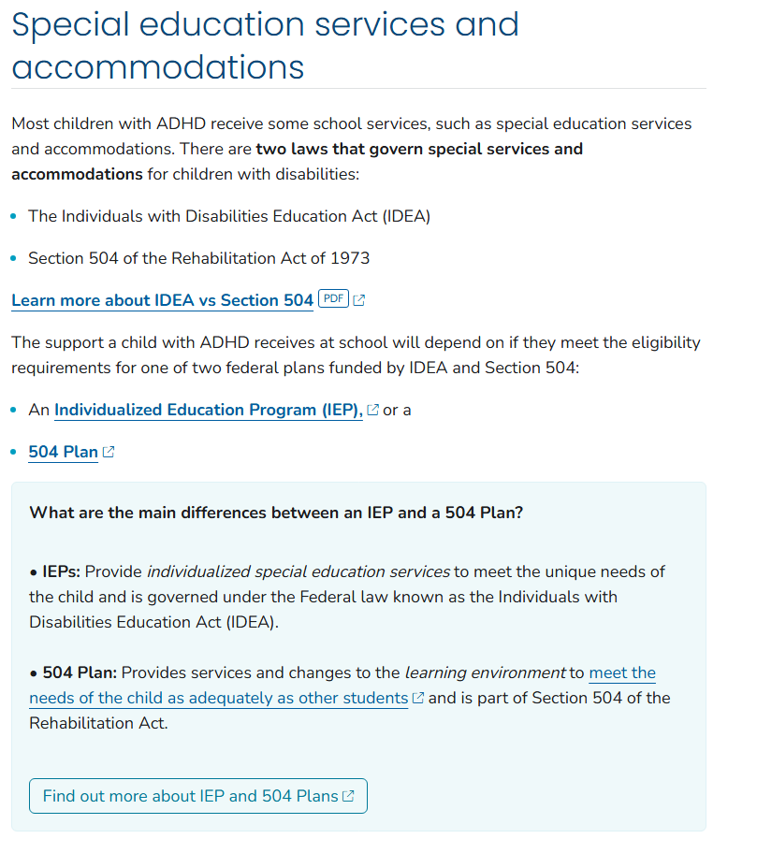
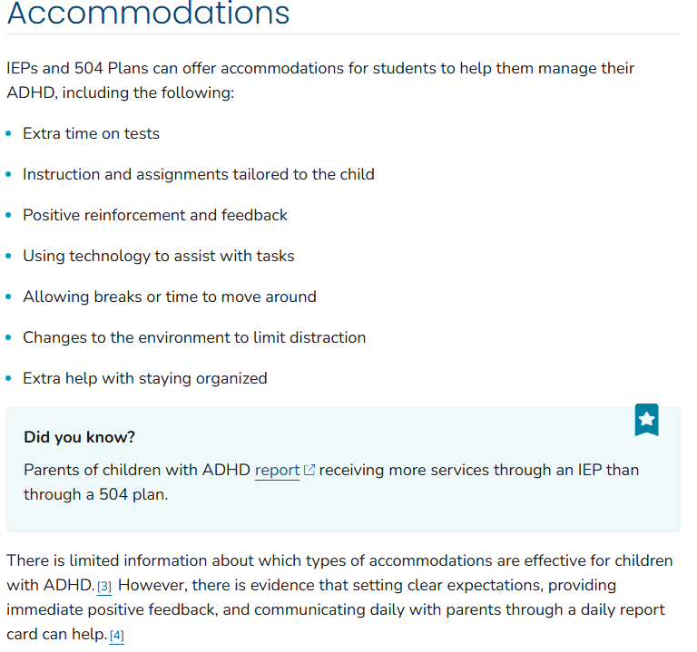

Slide 8
How should we adapt Sunday School rooms to meet the needs of neurodiverse students?
https://buildfaith.org/neurodiversity-in-the-classroom/
https://shinecurriculum.com/2023/09/13/elementor-20951/
https://www.weareprogressive.com/insights/universal-design-tips-that-support-a-neurodiverse-classroom\
https://www.sensoryfriendly.net/easy-steps-to-create-a-sensory-room-at-church/
Please summarize what should be in Church cocoons and sensory spaces based on these articles

Slide 9
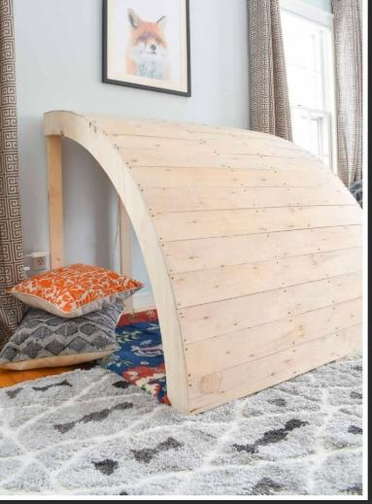
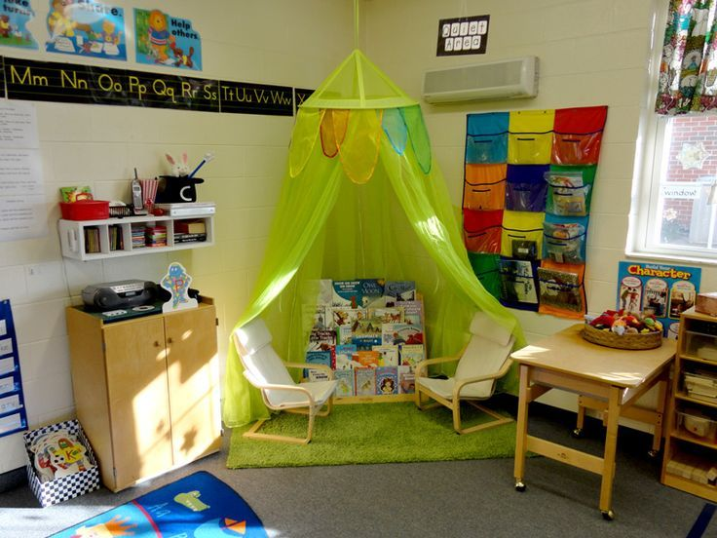
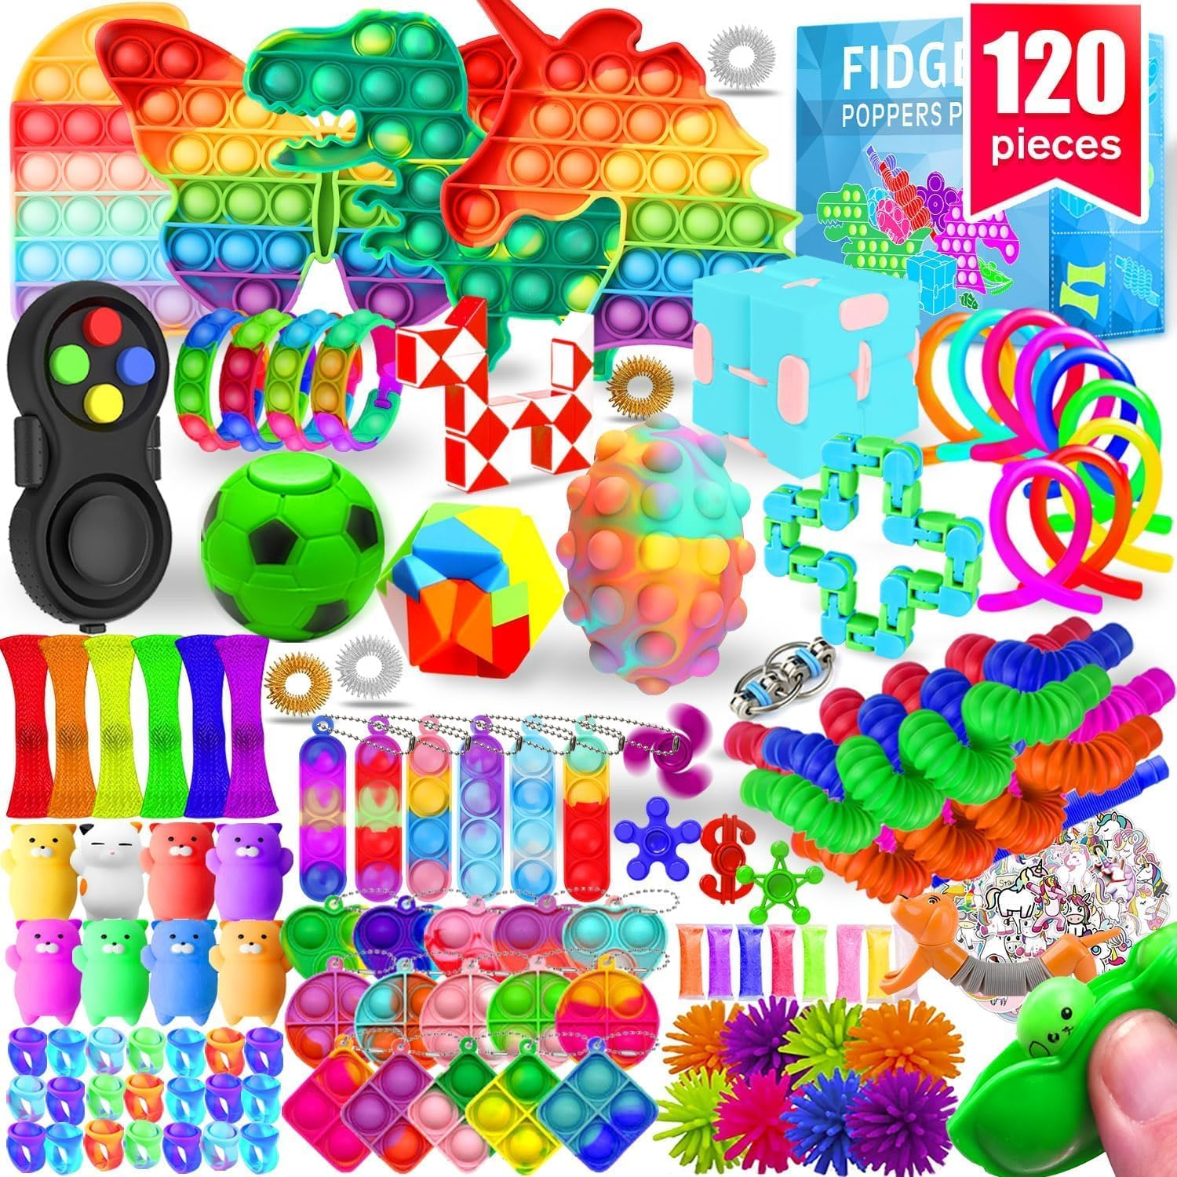
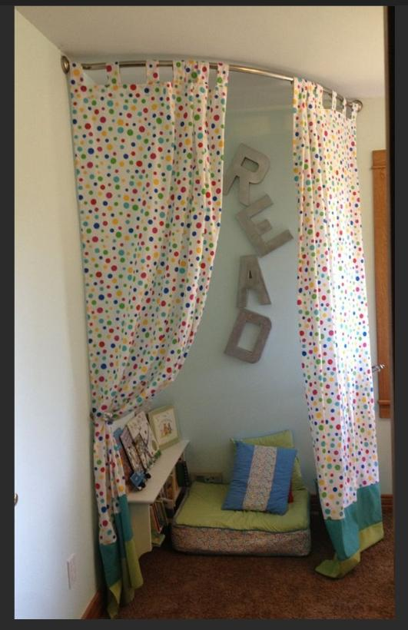
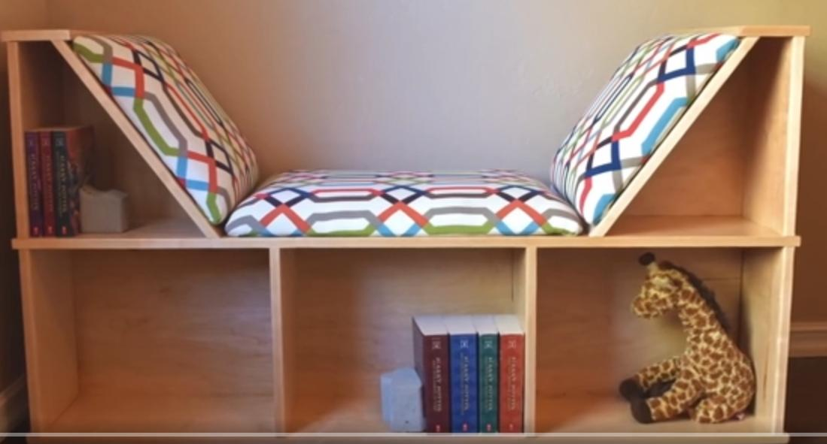
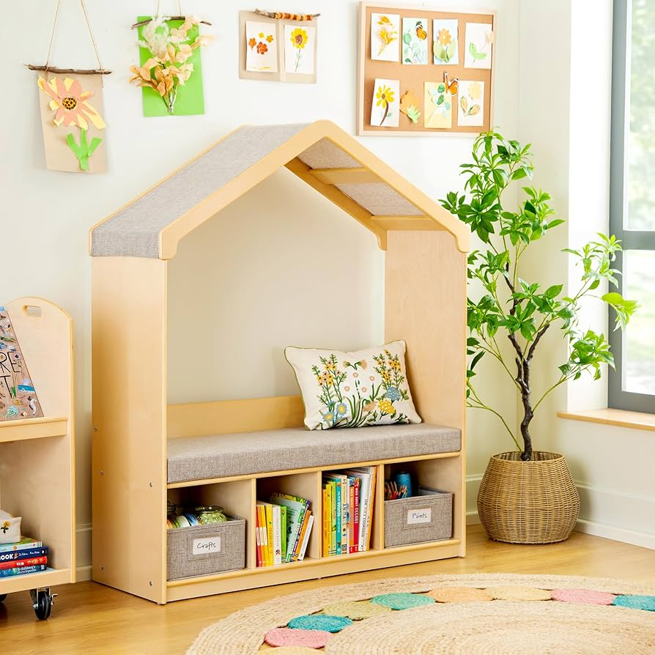
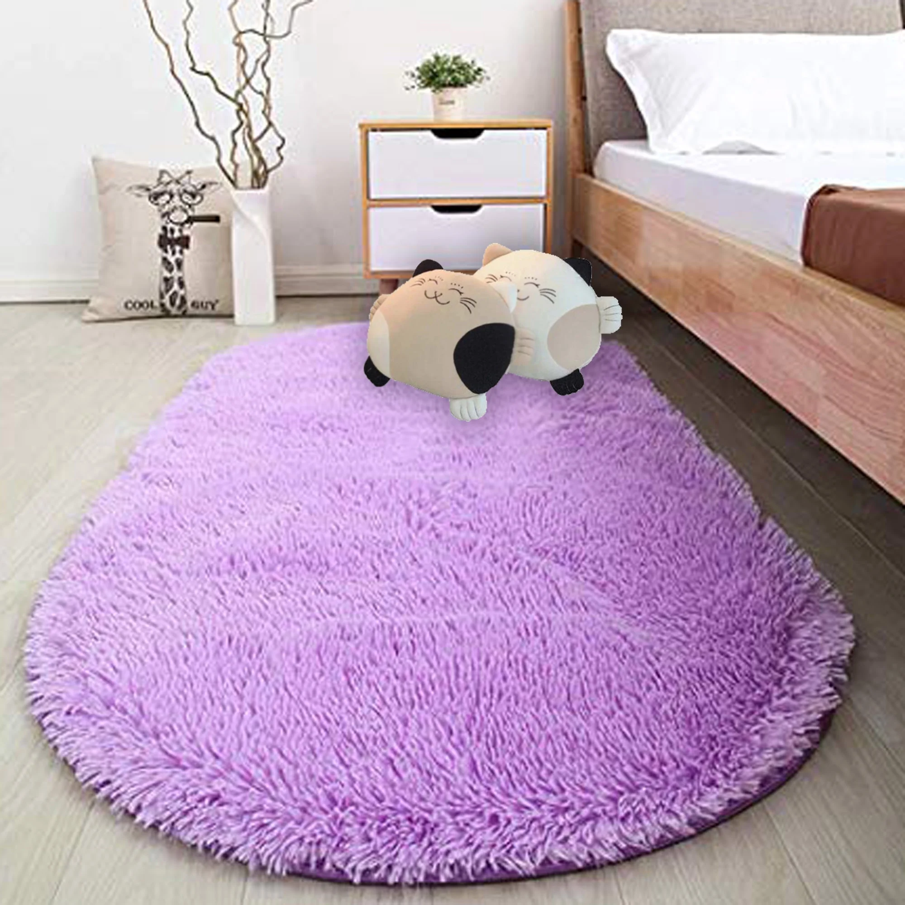
Cocoon corners: Key Principles
Have corners in all early elementary classrooms (“cocoon corners”)
In each “cocoon corner,” include a quiet zone for students who need a calm, retreat-like environment, as well as a comfortable area to decompress
The cocoon corners have a lot of fidgets so kids have something sensory to focus on
Use soft, adjustable lighting in these areas to create a soothing atmosphere and reduce overstimulation.
Use sensory-friendly materials that offer additional comfort and tactile feedback.
Add reading material and things to do
Ensure the cocoons are modular (so they can be moved easily)
Make the cocoon corners easy to use and understand for all volunteers.
Notes:
Need to do this for 4 classrooms

Slide 10
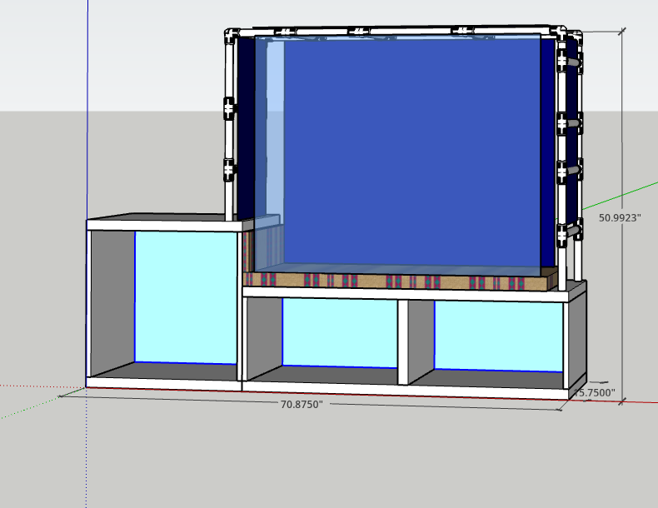
What I am going to build
Pre-fabricated benches as a a
Storage for fidgets and sensory objects
PVC “cocoon” shell to make storage and transport easy.
Soft (washable) fabrics to block light.
Sheer front curtain for visibility
Comfortable sitting area with calming colors and fabrics
Cost effective using safe and kid-friendly materials.
Calming colors throughout

Slide 11
Ideas for fidgets and sensory objects
Squish ball
Fidget Spinners

Slide 12
Timeline
Attend SNP Reach to understand evidence-based solutions for neurodiverse students in classrooms.
Research how to build calming corners in church environments
Approvals (Boy Scouts, Overlake)
Fundraising
Create training materials
For actual project, build/install would be 4 days:
Day 1: Building the reading area
Day 2: Sewing the cushions and curtains
Day 3: Installing the corners in the classrooms
Day 4 (before Sunday service): Train volunteers on the new corners

Slide 13
What I need to buy:
Dimmed lights plug version - Link
Sensory water tower - Link
Sensory Board - Link
Block toy - Link
Wood for structure building
Sensory magnets - Link
Bubble tubes
Fibre Optic cables
Bean bags
Carpets
Sensory pads
A lot of other things

Slide 14
Questions and requests for Pastor Tina:
General feedback and approval for cocoon corners
Thoughts on timeline?
Can these corners also be used for the pre-school?
How to fundraise (any ideas?)
Family member donations
Online fundraising
SNP reach group donations
Overlake Donations/Resources via the congregation
Anything else?

